Slide 1

DETECTION OF ANOMALOUS BEHAVIOR OF SMARTPHONE DEVICES USING CHANGE POINT ANALYSIS & MACHINE LEARNING
By
J.R. Sai Lohitha 19KA1A0519
A. Sathwika 19KA1A0504
V. Hari Sree Rani 19KA1A0517
M. Premalatha 19KA1A0555
Under the esteemed guidance of Mrs.K.R. Lavanya, _{M.Tech}
Assistant Professor(Adhoc)
DEPARTMENT OF COMPUTER SCIENCE AND ENGINEERING
JAWAHARLAL NEHRU TECHNOLOGICAL UNIVERSITY ANANTAPUR COLLEGE OF ENGINEERING KALIKIRI
Kalikiri-517234

Slide 2

CONTENTS
Introduction
Abstract
Problem Definition
Existing System
Proposing System
System Requirements
Modules
Module Description
UML Diagrams
Results
Conclusion
References

Slide 3
INTRODUCTION
Smartphones have become essential devices that currently most users relay on to complete their crucial activities in their daily tasks.
However, the increasing number of users also enables hackers to generate several malicious applications
Therefore, the security threats have increased on a mobile device, such as phishing, spyware, adware, SMS, and Email spam threat
Considering this malicious activities in smartphone’s overall power consumption is a better choice for detecting malicious behavior.

Slide 4
ABSTRACT
Since the emergence of malware, detecting abnormal activity on cell phones has become difficult.
Other approaches identify malicious behaviour by examining static application code attributes or dynamic data samples collected from hardware or software.
We present a generic methodology that employs a data collector and analyser to uncover harmful activity through data analysis.
Our procedures take less time to collect data than manual methods, as we employed SVM algorithm, Decision Tree, XGBoost Classifier and AdaBoost Classifier.
01
02
03

Slide 5
PROBLEM DEFINITION
In normal conditions, every device must act or behave in the way that the manufacturer designed it to. However, several factors can change the normal behavior of hardware and software components, causing anomalous behavior.
Anomalous behavior is considered as any change or deviation in a normal data pattern seen from data analysis.
The main factors that affect normal behavior include hardware and software aging, hardware trojan, firmware updates, and malicious code embedded in new Apps.
This project focuses on recognizing malicious behavior injected due to malicious Apps installed by the user or other sources in a smartphone using anomaly detection methodologies.
01
03
02
04

Slide 6
EXISTING SYSTEM
In the existing system [1],implementation of machine learning algorithms is bit complex to build due to the lack of information about the data visualization.
Mathematical calculations are used in existing system [2] for model building this may takes the lot of time and complexity.
[3] has several machine learning models to classify whether there is anomalous behavior or not in the android device, but none have adequately addressed this misdiagnosis problem.
Also, similar studies that have proposed models for evaluation of such performance classification mostly do not consider the heterogeneity and the size of the data
To overcome all this, we use machine learning packages available in the scikit-learn library

Slide 7
PROPOSING SYSTEM
Provide an end to end methodology to automatically collect data and analyze them to detect anomaly in smartphones
Collects the network traffic and TCP packets shall be filtered, the feature selection and extraction are done.
Functions chosen from the various network features are extracted, labelled and stored.
Machine learning classification entails in which the information in a database forms the classification machine to produce a detection model
We propose a Support Vector , Decision Tree, XG Boost Classifier, AdaBoost Classifier as our classification techniques.

Slide 8
SYSTEM REQUIRMENTS
Hardware Requirements
Processor : Intel Core i7
RAM : 4 GB
Software Requirements
Coding Language : Python 3.8
IDE : PyCharm 2022.2.3
Framework : Flask
Operating system : Windows 10

Slide 9

MODULES:
SYSTEM MODULE
USER MODULE

Slide 10
User:
Is designed to enable the user to interact with the system and perform various tasks.
The user module includes several functionalities such as loading the data, working on data, selecting models, generating results, and viewing the homepage, among others.
Users can access the system through the homepage and can upload the required data set. The data set is then pre-processed to eliminate inconsistencies and irrelevant data. The user can then choose a specific model and use it to train the data
Model selection:
The goal of this step is to select the best machine learning algorithm that can accurately classify the collected data into either anomalous or normal behaviour
In this project, four different algorithms have been selected for the model selection
To select the best algorithm for this project, several factors need to be considered, including the accuracy, training and testing time, and computational resources required

Slide 11
System Modules
1)Data Collection:
System checks for data whether it is available or not and load the data in csv files.
As stated earlier, the data for this research consisted of 150,000 malicious files and 87,000 benign executables of Windows format. The benign executables were retrieved from fresh installation of Windows 7, Windows 8, Windows 10, Windows Server 2008, and Windows Server 2012.
To foster research on Android malware and to enable a comparison of different detection approaches, we make use of the datasets Drebin publicly available on Kaggle. The samples have been collected in the period of August 2010 to October 2019 and were made available to us by the Mobile Sandbox project.

Slide 12
2)Pre-processing:
Data need to be pre-processed. According the models it helps to increase the accuracy of the model and better information about the data. A)Feature Extraction
Each sample is described with a features vector to identify potentially malicious applications. Transforming raw data into numerical features that can be processed while preserving the information in original data set. So that potential of feature extraction system can be leveraged to combat with unfamiliar malwares.
B)Feature Selection
A method for automatic feature selection in anomaly detection is proposed which determines optimal mixture coefficients for various sets of features. The method generalizes the support vector data description (SVDD) and can be expressed as a semi-infinite linear program that can be solved with standard techniques. C)Dataset Standardization
Irrelevant imported functions are disregarded and multiple functions with a similar effect can be mapped to a single action
02
2b
2A
2C

Slide 13
3)Analysing and Detecting
Anomalous Analysis
We demonstrate that with careful selection and extraction of the features and are applied with SVM, Decision Tree, XG boost and Ada boost machine learning algorithms respectively.
we can build baseline models of benign program execution and use these profiles to detect deviations that occur as a result of malware exploitation.
Model Building:
Monitoring Power Consumption Battery power consumption is one of the major limitations of mobile phones that limit the complexity of anti-malware solutions.
It also brings the challenge for mobile malware as all critical behaviors for malware propagation such as accessing WIFI or Bluetooth consume significant battery power .
Any malicious behaviors caused by malware also involve extra power consumption are listed and detected.
4)Generated Score:
Here user view the score in % according to the dataset uploaded with significant algorithms accuracies i.e., Support Vector Machine, Decision Tree, XG booster, Ada booster
5)Generate Results:
We train the machine learning algorithm and predict the anomalous behaviour

Slide 14
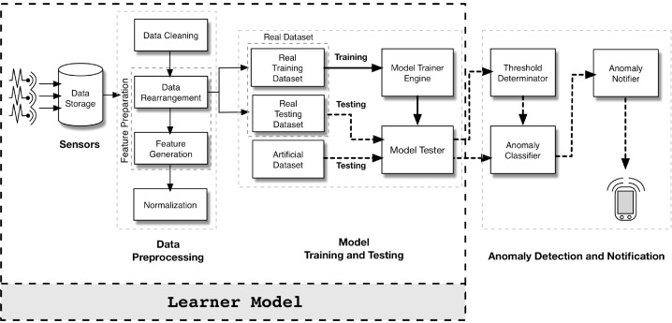
BLOCK DIAGRAM
Malware Detection
Anomaly behaviour identification
Data set
SVM,
Decision Tree

Slide 15
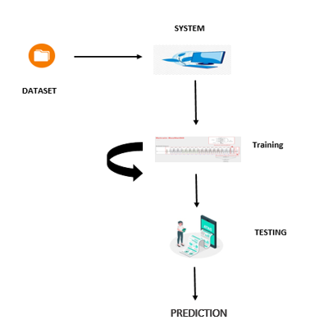
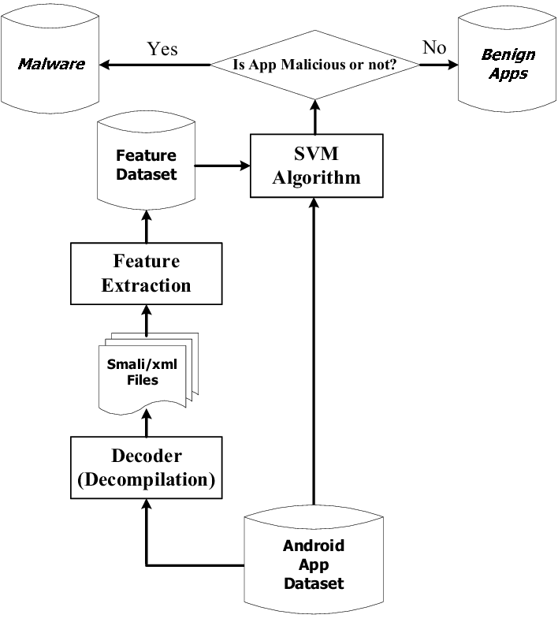
SYSTEM ARCHITECTURE
Machine learning algorithms
CSV binary file
Drebin Data Set

Slide 16
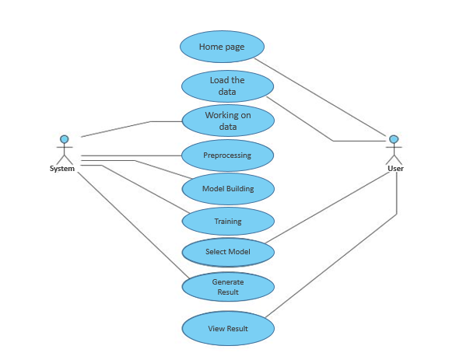
USE CASE DIAGRAM
01
02
03

Slide 17
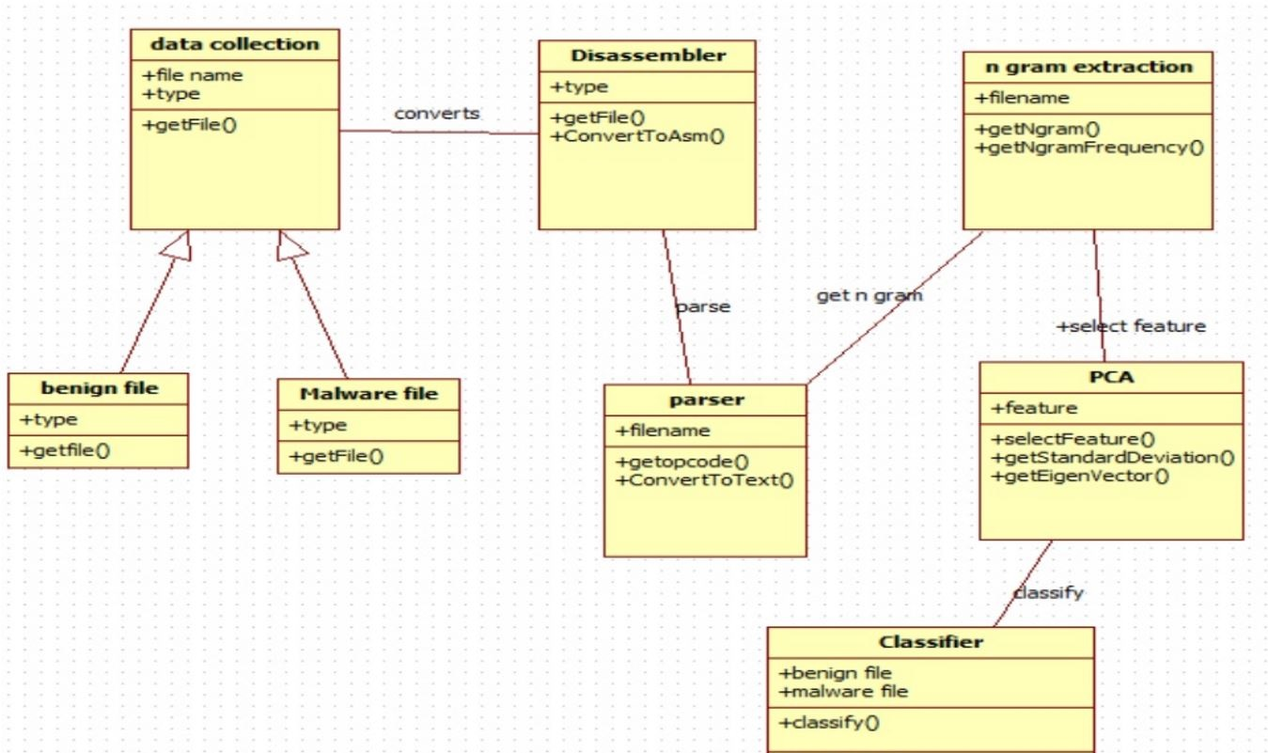
CLASS DIAGRAM
feature extraction
model tester
anomalous prediction
model training

Slide 18
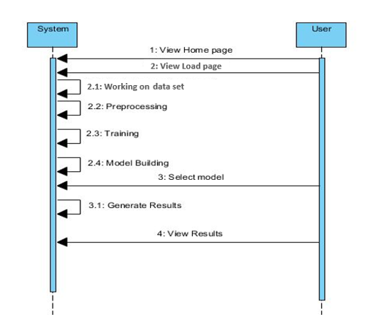
SEQUENCE DIAGRAM

Slide 19
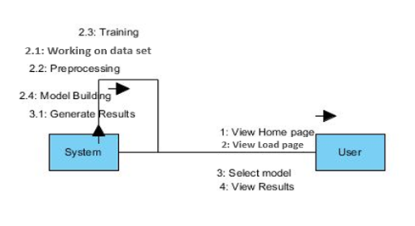
COLLABORATION DIAGRAM:

Slide 20
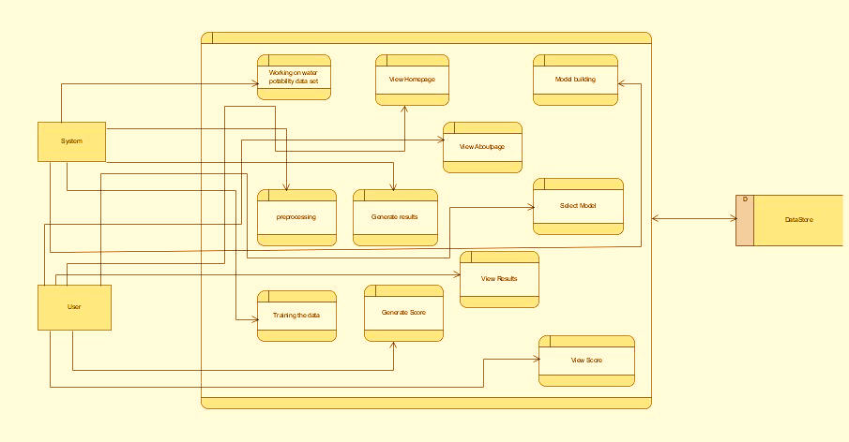
DFD DIAGRAM:
Working on derbian data set
View homepage
Model Building
System
View About Page
Select Model
Svm/ Decision tree/ xg booster/Ada booster
pre-processing
Generate results
Data Set
View Results
Anomalous or not
User
Training the data
Generate Score
View Score according to algorithm

Slide 21
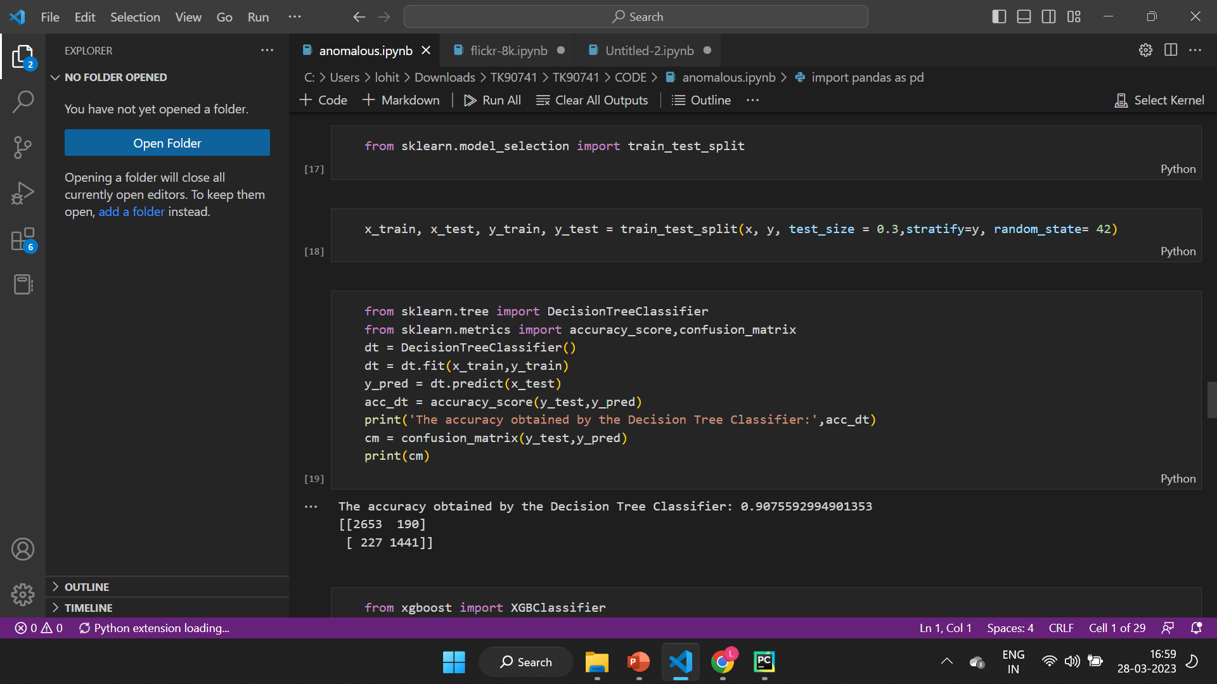
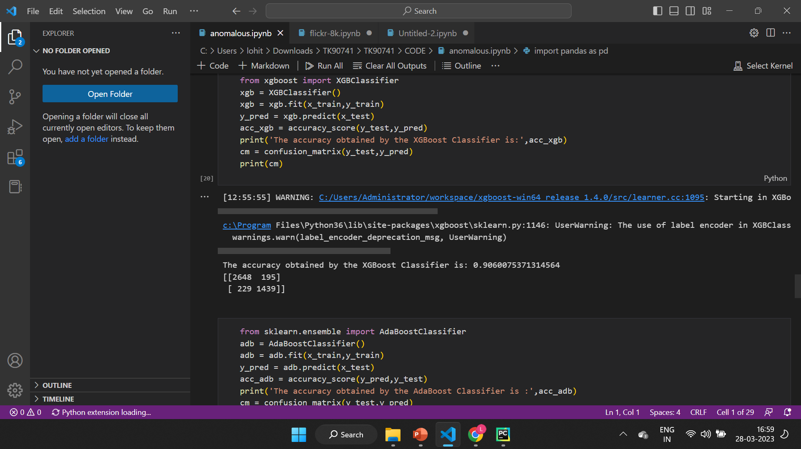
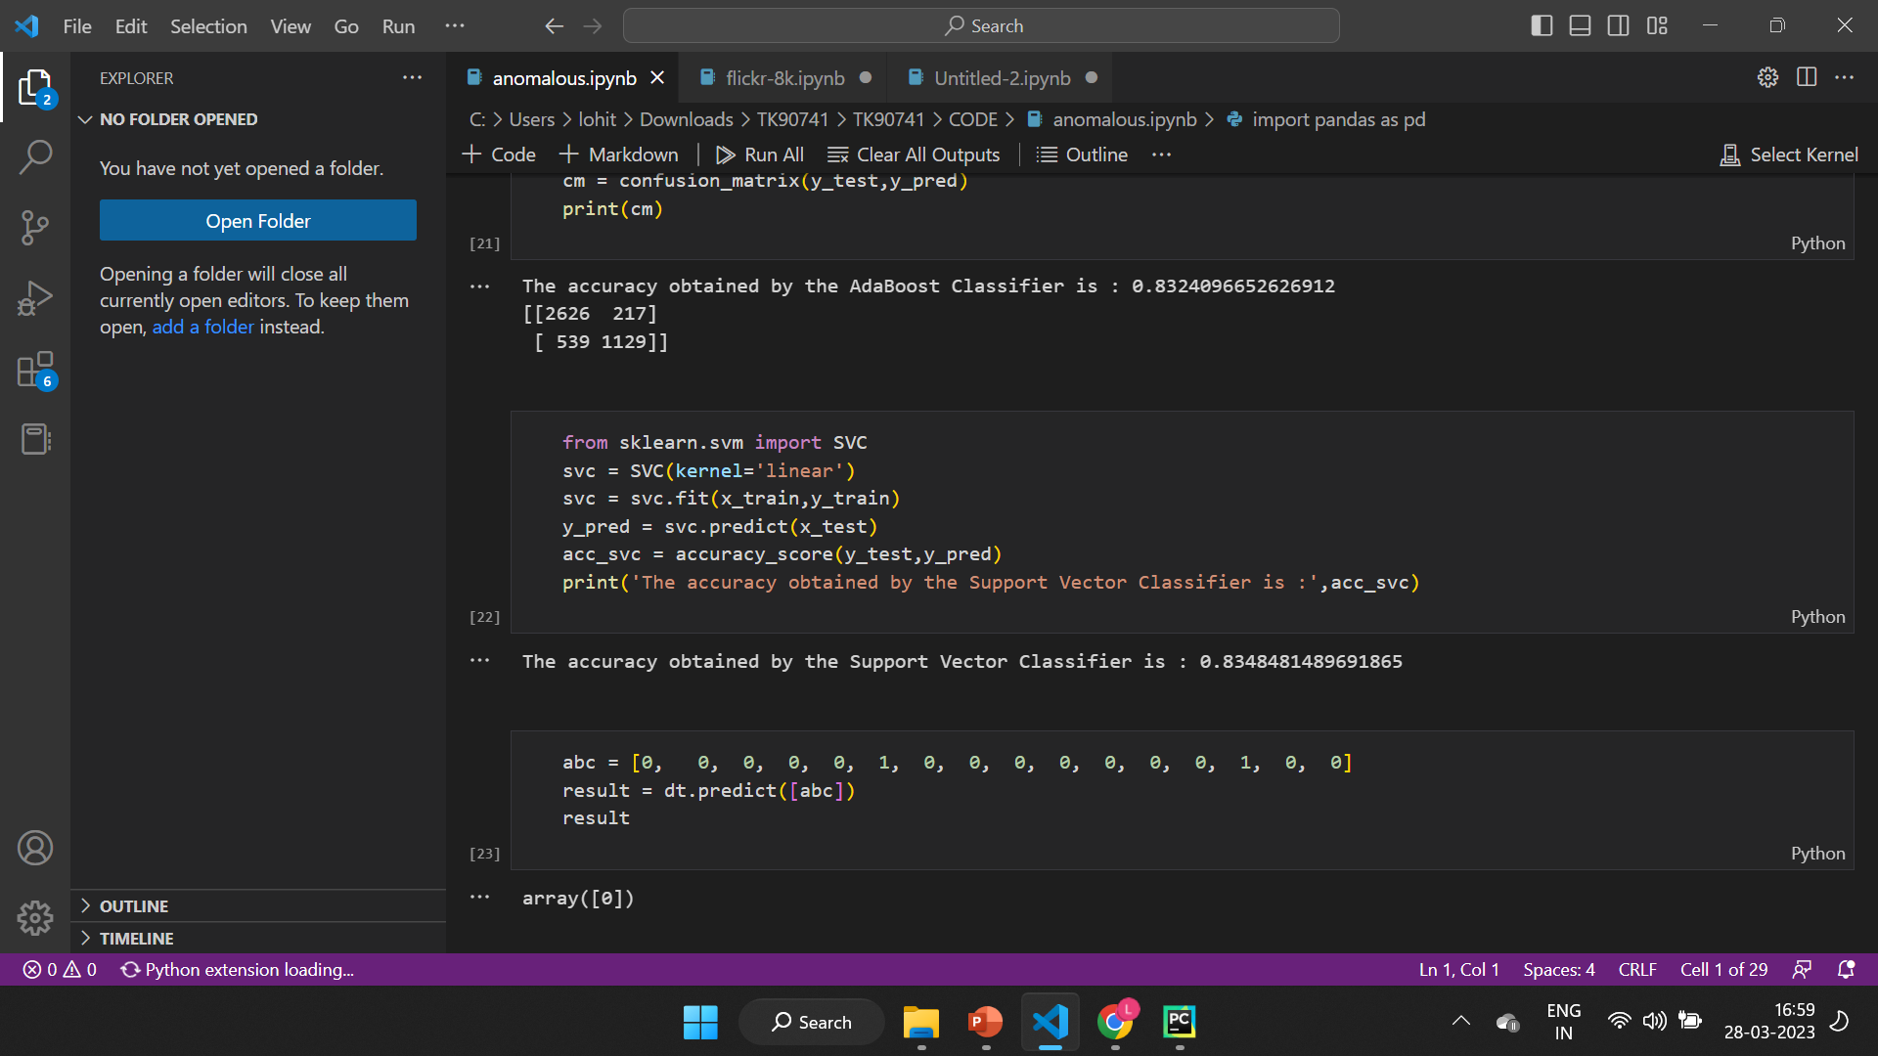
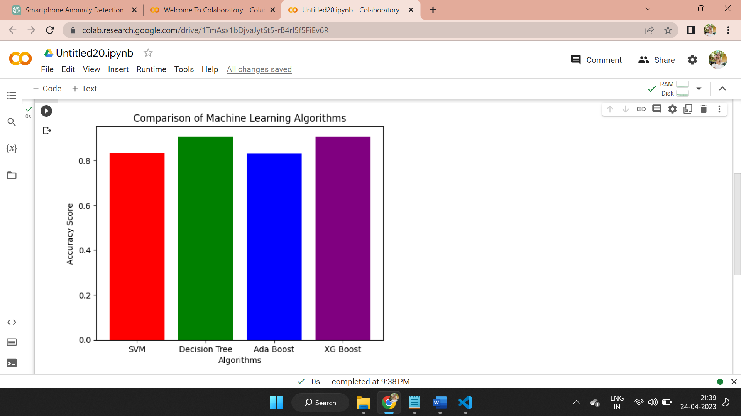
RESULTS
Summary:
Training and testing performed by splitting the file
The accuracy score and confusion matrix is obtained with Four algorithms and respective accuracy score are shown in the graph.
Decision tree - 90.7%
XG Boost - 90.6%
Ada Boost - 83.2%
SVM - 83.4%
Based on above predictions among all, decision tree algorithm is more accurate.

Slide 22
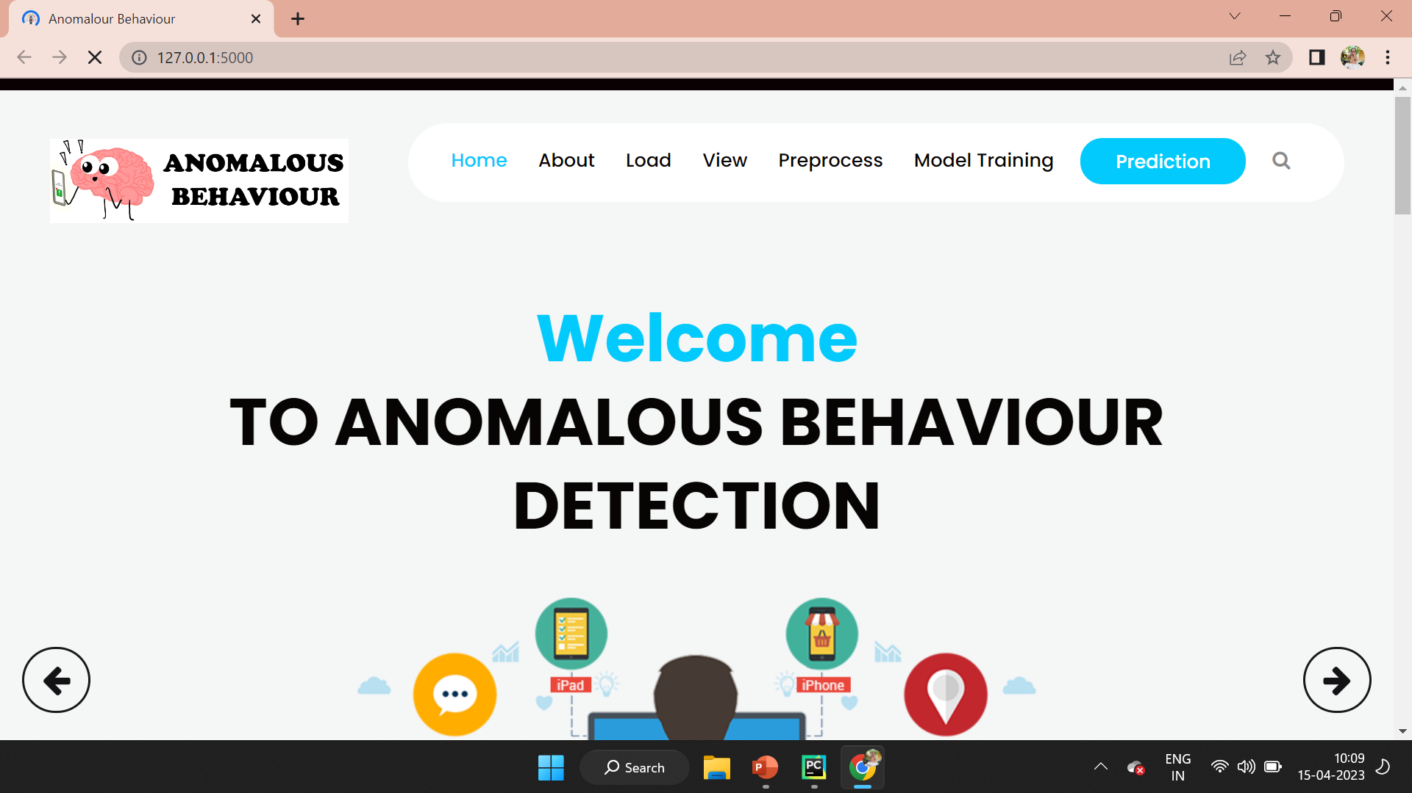
HOME PAGE

Slide 23
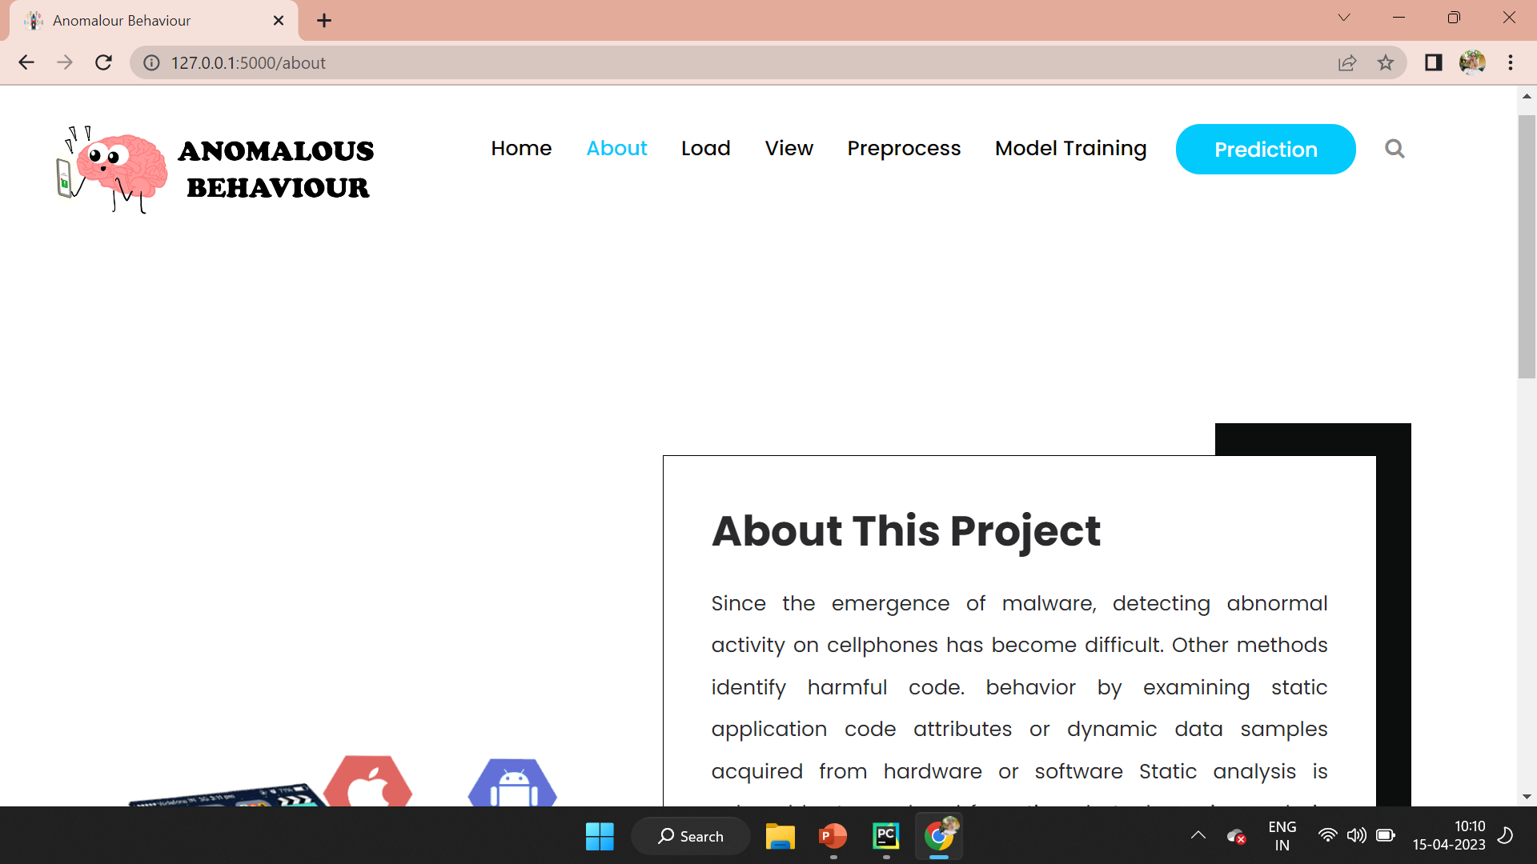
ABOUT PAGE :

Slide 24
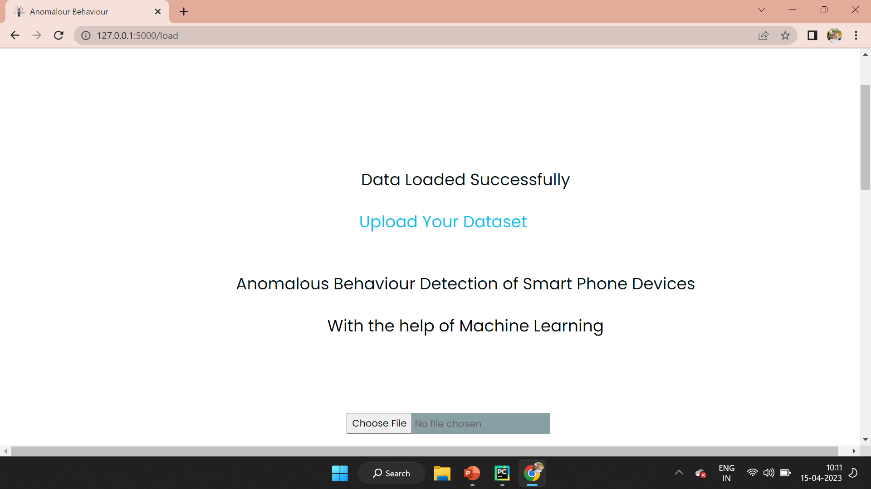
LOAD PAGE :

Slide 25
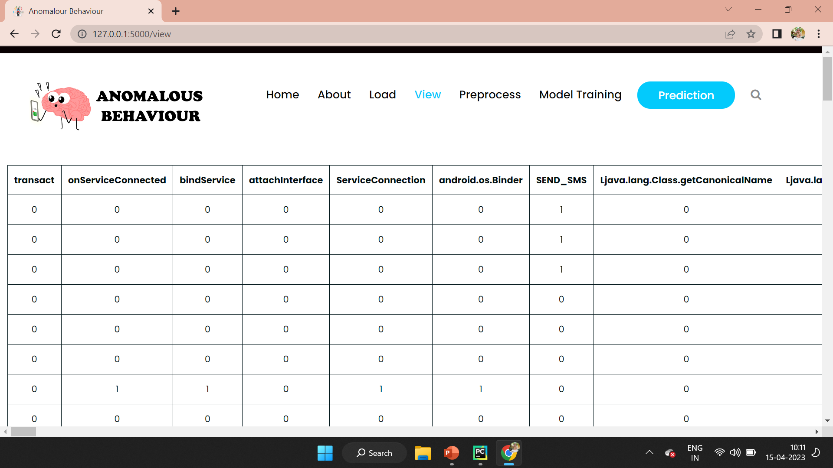
VIEW PAGE :

Slide 26
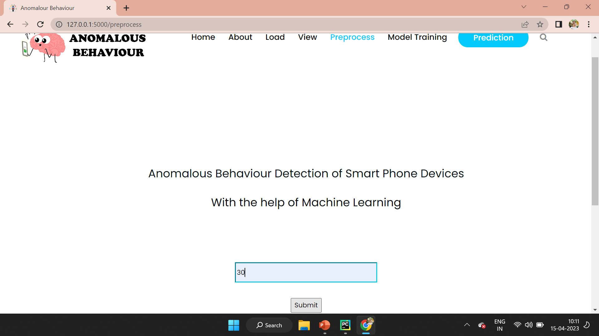
PREPROCESS PAGE :

Slide 27
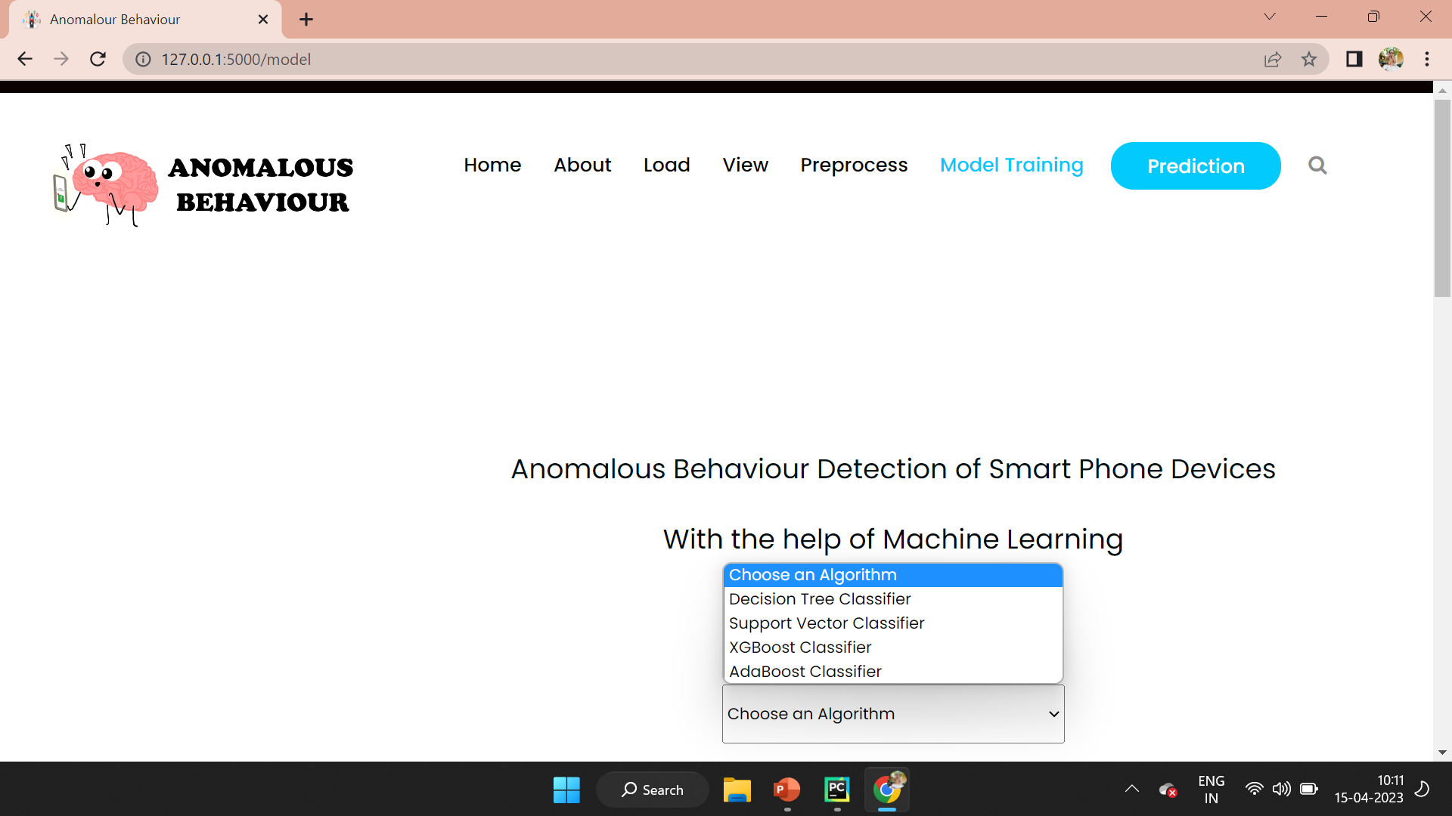
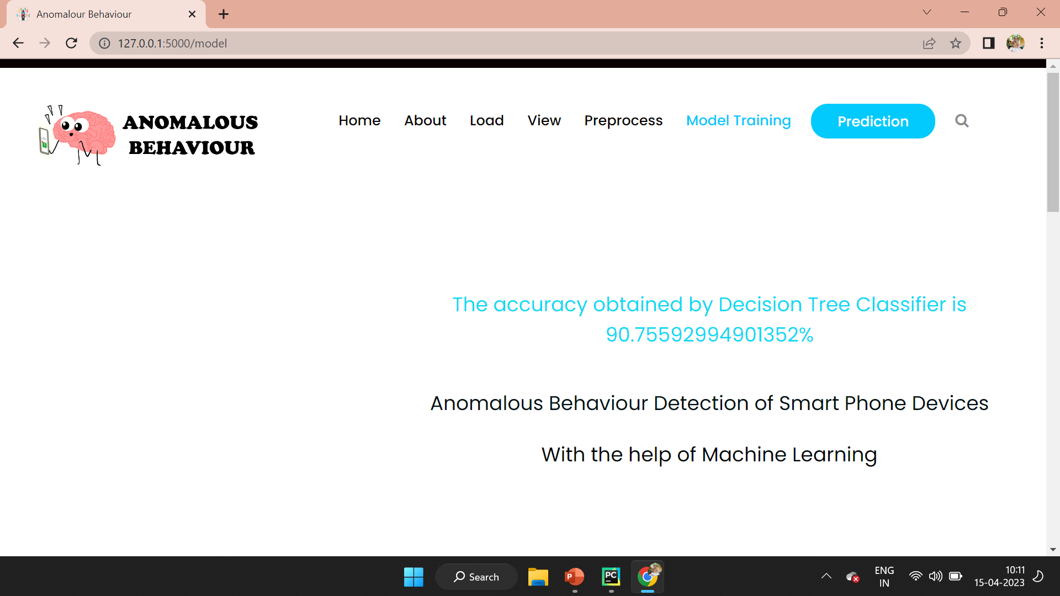
MODEL TRAINING PAGE :
ACCURACY SCORE REPORT :

Slide 28
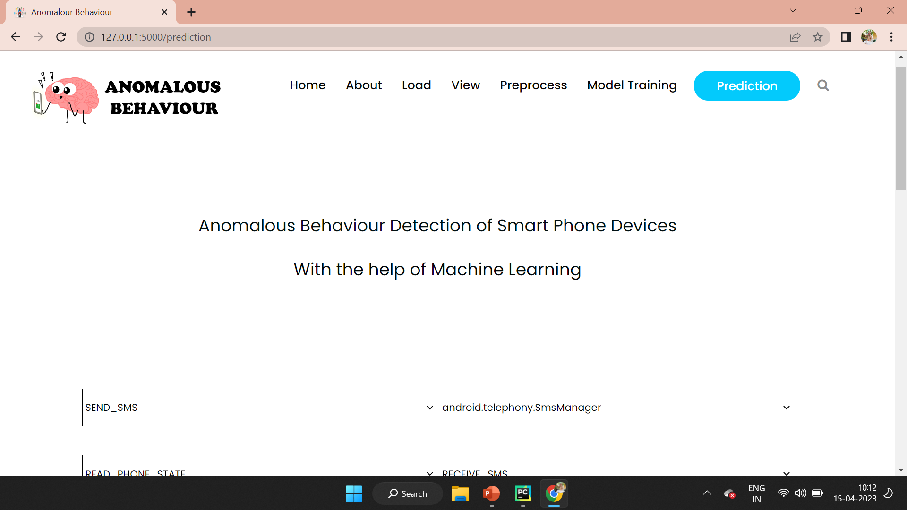
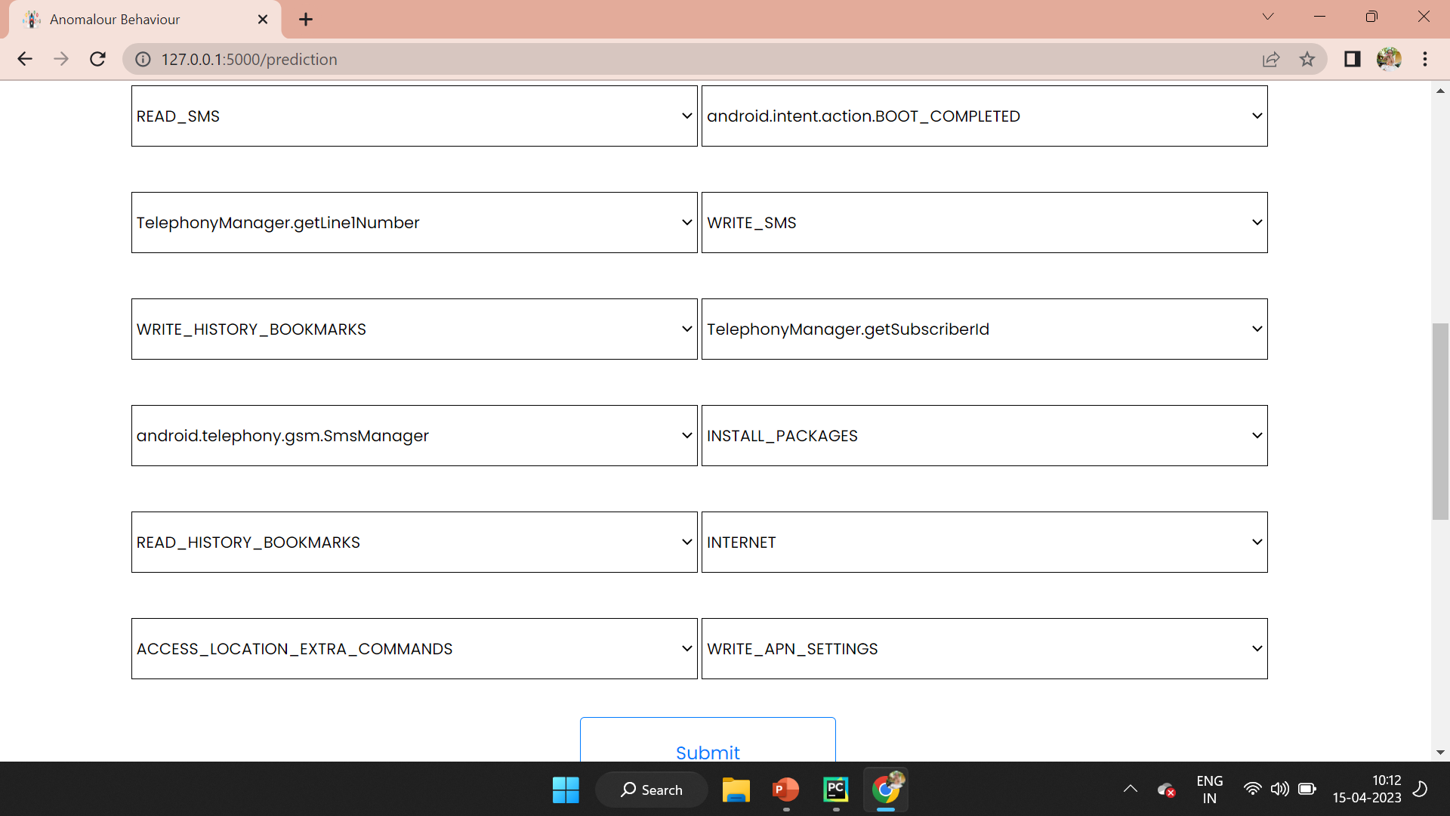
PREDICTION PAGE :

Slide 29
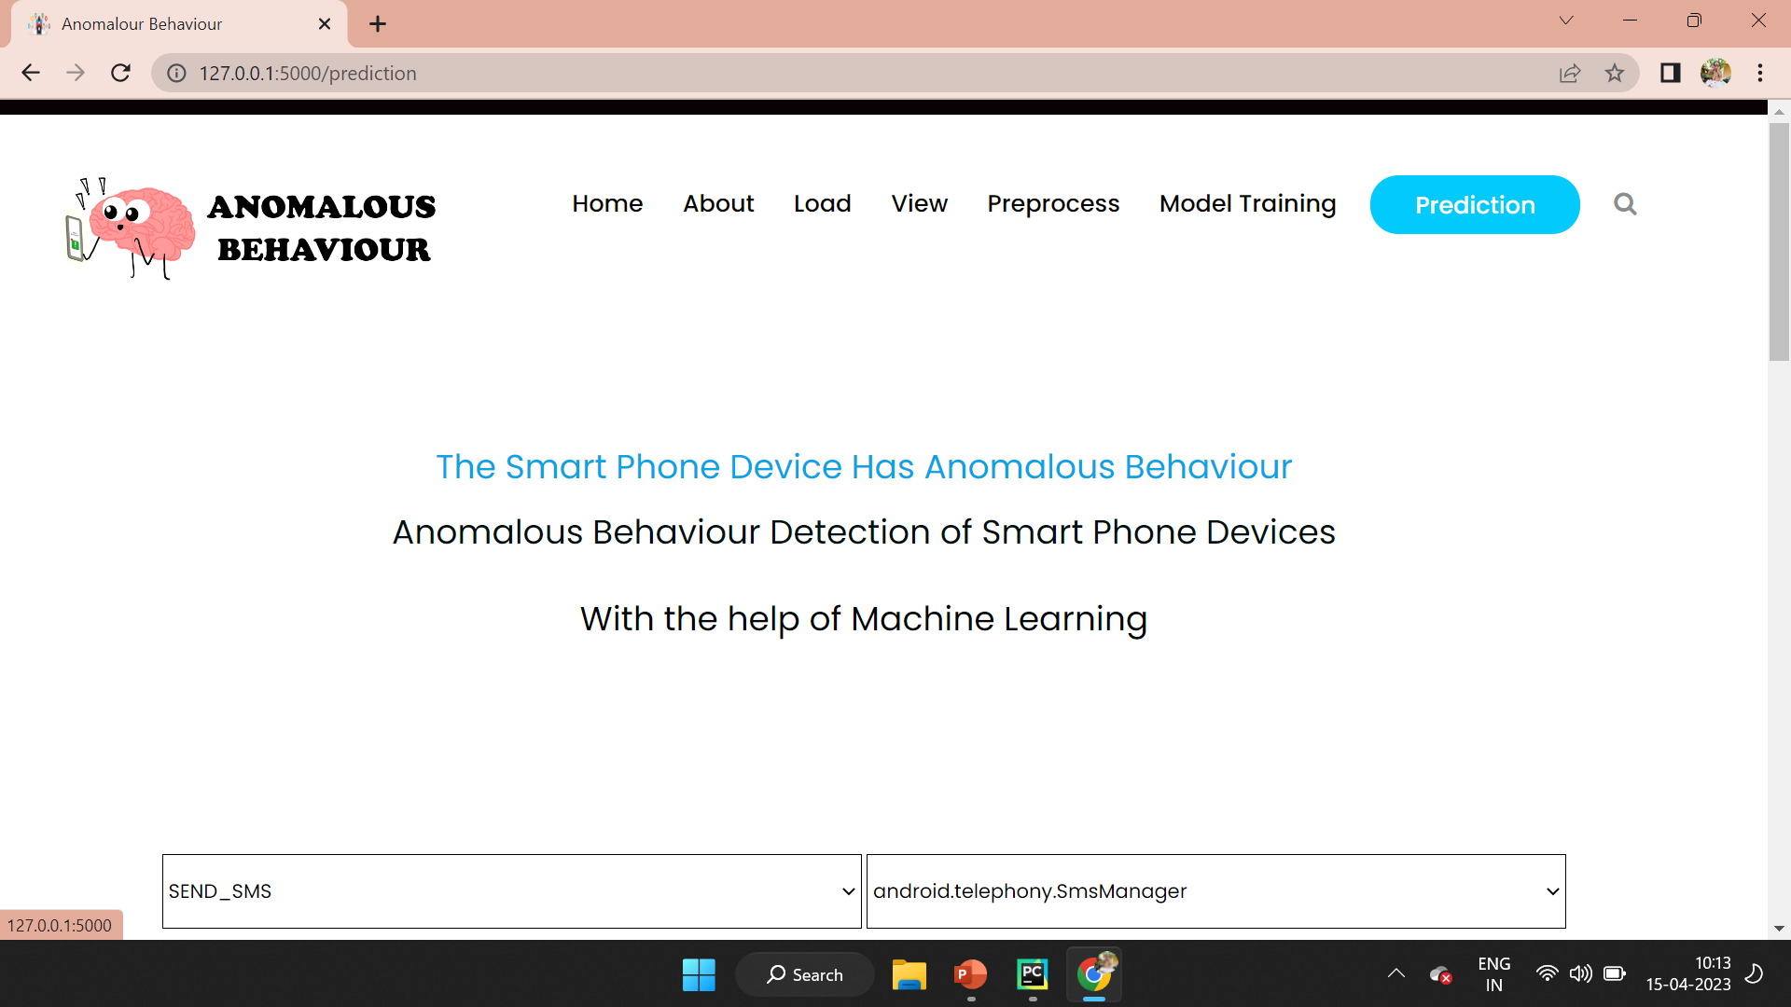
ANAMOLOUS BEHAVIOUR CLASSIFING PAGE :

Slide 30
CONCLUSION
This novel methodology for identifying anomalous smartphone behaviour is proposed using changepoint detection theory to extract features and four machine learning techniques to train a classifier based on the power consumed by the smartphone
The proposed methodology outperforms other existing methods in terms of F1-measure accuracy, and it can recognize malware operating within short timeframes, which is a significant advantage over other techniques
1
2
3
4
Our results show that the proposed methodology can effectively detect anomalous applications with high accuracy
We conduct experiments on a dataset of power consumption traces collected from a set of smartphones running both benign and malicious applications.
6
Future work for this project includes applying the methodology to real applications instead of using an emulated collected data
5
This would provide more insight into the effectiveness of the approach in detecting actual anomalous behaviour

Slide 31

REFERENCES
01,02
[1]H. E. Fiky, A. Elshenawy and M. A. Madkour, "Detection of Android Malware using Machine Learning," 2021 International Mobile, Intelligent, and Ubiquitous Computing Conference (MIUCC), Cairo, Egypt, 2021, pp. 9-16, doi: 10.1109/MIUCC52538.2021.9447661.
[2] Y. Zhou and X. Jiang," Dissecting android malware: Characterization and evolution" In proc. 2020 IEEE Symposium on Security and Privacy (SP), San Fransisco, CA, USA, 20-23 May 2012, pp. 95-109.
03,04
[3]Milosevic, N., Dehghantanha, A. and Choo, K.-K.R. (2019) "Machine learning aided Android malware classification". Computers & Electrical Engineering, 61. pp. 266 274. ISSN 0045-7906.
[4]R. Elnaggar, K. Chakrabarty, and M. B. Tahoori. Hardware trojan detection using changepoint-based anomaly detection techniques. IEEE Transactions on Very Large Scale Integration (VLSI) Systems, pages 1–14, 2019.
05,06
[5]Ricardo Manzano, Abdurhman Albasir, Kshirasagar Naik, Jim Kozlowski, and Nishith Goel. Detection of anomalous behavior in wireless devices using changepoint analysis. In 2019 IEEE International Congress on Internet of Things (ICIOT), pages 82–90. IEEE, 2019.
[6]Yueyan Zhi, Zhangjie Fu, Xingming Sun, and Jingnan Yu. Security and privacy issues of uav: A survey. Mobile Networks and Applications, pages 1–7, 2019.

Slide 32


